Slide 1
Edinburgh Business School MBA
AUC Academic Partner
Strategic Planning
Module 8
Implementing and Evaluating
Strategy
Instructor: Moataz Darwish, MBA

Slide 2
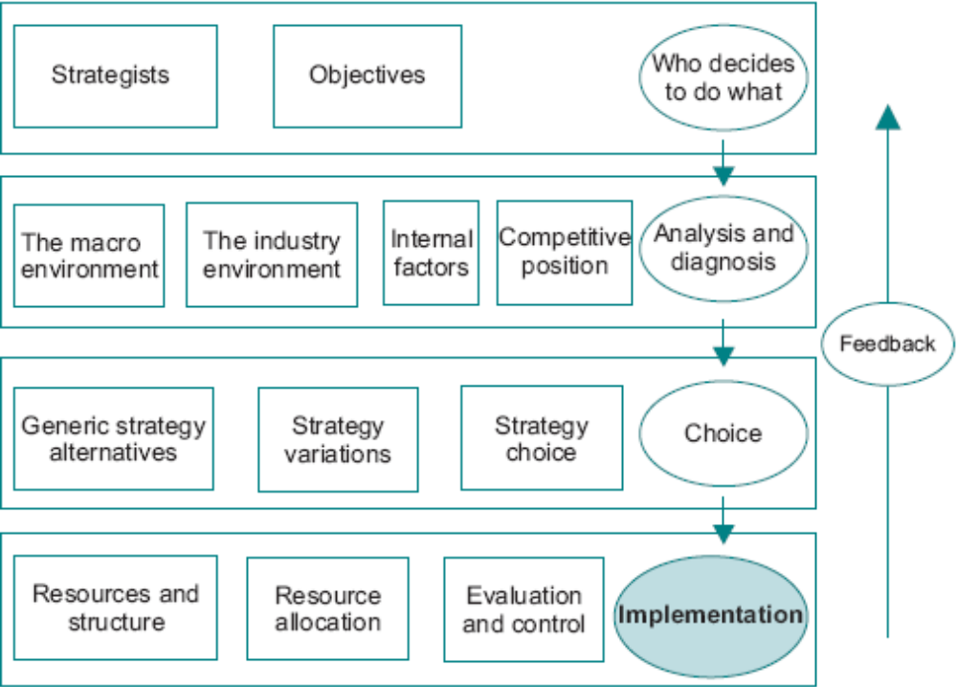
The Model
EBS MBA / AUC

Slide 3
Contents
Implementing Plans 8/2
Organizational Structure 8/3
Resource Allocation 8/6
  Management of Change 8/6
  Critical Success Factors 8/7
  Management Style 8/7
  Budgets 8/8
  Incentives and Alignment 8/9
  Setting Sales Targets 8/10
  Resource Planning 8/11
Evaluation and Control 8/12
  Monitoring Market Share 8/14
  Monitoring Profitability 8/15
Feedback 8/18
The Augmented Process Model 8/19
Postscript: Strategic Planning Works 8/23
EBS MBA / AUC

Slide 4
Implementing Plans
Difficult to isolate implementation as an independent activity from planning in practice.
Choosing strategy is not an end in itself; unless there is a mechanism for making it happen it is a somewhat pointless activity.
Feedback process is of at most importance.
  Feedback and continuous reaction are important elements of the process model.
EBS MBA / AUC

Slide 5
Organizational Structure
The question of: whether structure follows strategy or vice versa?
  Functional (U form)
  Divisional (M form)
  Holding company
  Matrix
  Networks
FUNCTIONAL STRUCTURE
  Groups individuals according to their specialties rather than around products.
DIVISIONAL STRUCTURE (products or geographical boundaries)
  Helps in resolving the principal/agent problem in that Divisional profitability can be more easily measured than functional returns.
  The extent to which divisions are independent of the corporate centre varies among companies;
  Differentiated product portfolio or operates in different countries
EBS MBA / AUC

Slide 6
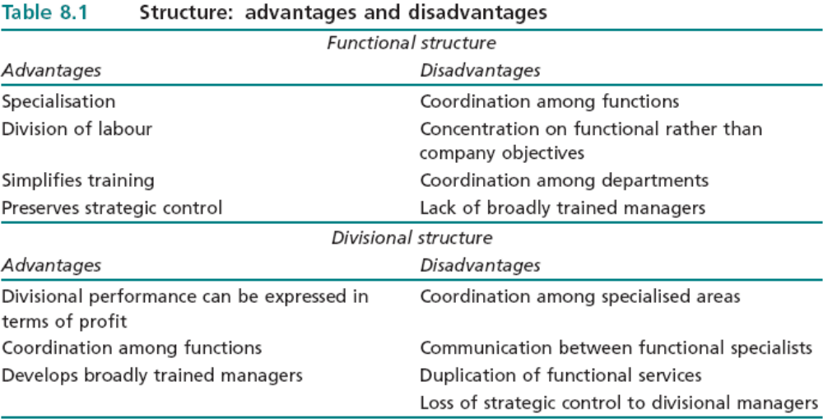
Organizational Structure
2 key questions to ask:
How different forms of organisation are likely to contribute to the creation of value?
Is the structure likely to be consistent with, or flexible enough to deal with, predicted changes?
EBS MBA / AUC

Slide 7
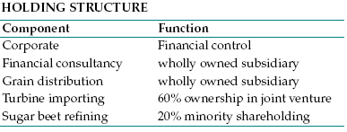
Organizational Structure – Holding structure
the conglomerate has no particular logic to the incorporation of the individual businesses and the centre plays a less direct role in the determination of strategy than in the divisional company
much looser than the divisional structure, although the financial controls which it imposes on the individual businesses may be extremely strict.
several apparently unrelated products in the portfolios. But the Corporate function in the holding structure is confined to financial control while the divisional Corporate function extends to various dimensions of parenting.
EBS MBA / AUC

Slide 8
Organizational Structure
A less common form of structure is the matrix - organising along more than one dimension.
  two hierarchies and two bosses.
  problems of direction and control.
  can lead to employees lacking focus.
  cause principal/agent problems.
Another approach is networks - work groups may be organised by function, geography or customer base.
  relationships among groups are governed more by often changing implicit and explicit requirements of common tasks than by formal lines of authority.
  raises problems of direction and control.
EBS MBA / AUC

Slide 9
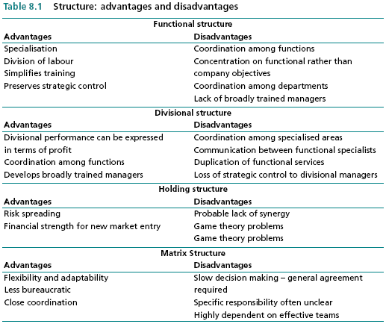
Structures advantages and disadvantages
EBS MBA / AUC

Slide 10
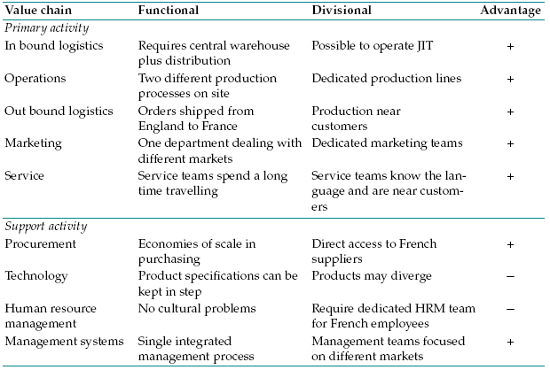
Structures advantages and disadvantages – value chain
a domestic electrical appliance manufacturer located in England decided to expand into France; because of different specifications required in France and the different language the Board considered setting up a separate manufacturing division in France rather than producing in England and maintaining the functional structure.
EBS MBA / AUC

Slide 11
Organizational Structure
When selecting the appropriate structure it is necessary to balance tradeoffs between
  scale and scope economies,
  transaction costs,
  agency costs and
  information flows.
  There is no single prescription, and the best organisation depends on individual circumstances.
The structure must be seen as a method of resource allocation which is relevant to the company objectives, the competitive environment and the strategy being pursued.
EBS MBA / AUC

Slide 12
Contents
Implementing Plans 8/2
Organizational Structure 8/3
Resource Allocation 8/6
  Management of Change 8/6
  Critical Success Factors 8/7
  Management Style 8/7
  Budgets 8/8
  Incentives and Alignment 8/9
  Setting Sales Targets 8/10
  Resource Planning 8/11
Evaluation and Control 8/12
  Monitoring Market Share 8/14
  Monitoring Profitability 8/15
Feedback 8/18
The Augmented Process Model 8/19
Postscript: Strategic Planning Works 8/23
EBS MBA / AUC

Slide 13

Resource Allocation
  Management of Change
    reallocation of resources involves changing what people do.
    faces ‘no change’ mentality problems
    number of techniques which can be applied to implement change:
      survey feedbacks, team building, confrontation and transactional analysis;
      in the strategy context, managers must recognise when the organisation is in need of help in facilitating change.
  Critical Success Factors:
    events which must occur, or things which must be done, in order to ensure that the strategy succeed.
    Needs detailed understanding of available resources, resources which will be required, sequence of events and how individuals are likely to react to the changes which they will experience.
Take the cases of attempting to convert a Question Mark to a Star compared with turning a Star into a Cash Cow. Four critical success factors have been identified that are common to both and the action associated with each is shown below.
EBS MBA / AUC

Slide 14

Resource Allocation
  3. Management Style:
    skills which individual managers possess, leadership style is key.
    company culture exert a significant impact on the ability of the organisation to undertake change.
  Budgets:
The problem of allocating budgets – both Corporate and SBU levels
At the corporate level the overall budget is rationed among competing alternatives on the basis of proposals submitted by SBUs.
At the SBU or functional level resources are allocated to individual managers so that they can carry out the tasks which are required to achieve the objectives of each investment;
There are at least two approaches to corporate resource allocation: Competitive bidding (allocate capital between the groups according to the ratio of the total requested by each and the group manager then allocates capital to the SBUs using the criterion of value created) & directly to SBUs by ratio of value added.
EBS MBA / AUC

Slide 15
Resource Allocation
  5. Incentives and Alignment:
    incentives should be related to the value creating activities
    incentive system MUST BE aligned with the value creation objective.
    For example, a production manager who is rewarded for minimising inventories can cause havoc with a marketing strategy aimed at achieving an increased market share.
  6. Setting Sales Targets:
    The allocation of resources to selling is a basic determinant of strategic success.
  7. Resource Planning:
    set up procedures to ensure that resources are used efficiently and that the components and linkages of the value chain are effective.
    communications between marketing and production IS KEY.
EBS MBA / AUC

Slide 16
Contents
Implementing Plans 8/2
Organizational Structure 8/3
Resource Allocation 8/6
  Management of Change 8/6
  Critical Success Factors 8/7
  Management Style 8/7
  Budgets 8/8
  Incentives and Alignment 8/9
  Setting Sales Targets 8/10
  Resource Planning 8/11
Evaluation and Control 8/12
  Monitoring Market Share 8/14
  Monitoring Profitability 8/15
Feedback 8/18
The Augmented Process Model 8/19
Postscript: Strategic Planning Works 8/23
EBS MBA / AUC

Slide 17
Evaluation and Control
Necessary to measure and evaluate actual performance to find out if the expectations are being fulfilled.
When the component parts of the plan have been made explicit, the plan provides a benchmark against which actual outcomes can be compared, so that when variations between expected and actual outcomes occur their causes can be investigated.
The reason for the shortfall will suggest whether action should be taken to achieve the original objectives, or whether the plan itself needs revision in the light of events; it is essential to identify whether the deviation from the plan is due to causes within the control of the company.
EBS MBA / AUC

Slide 18
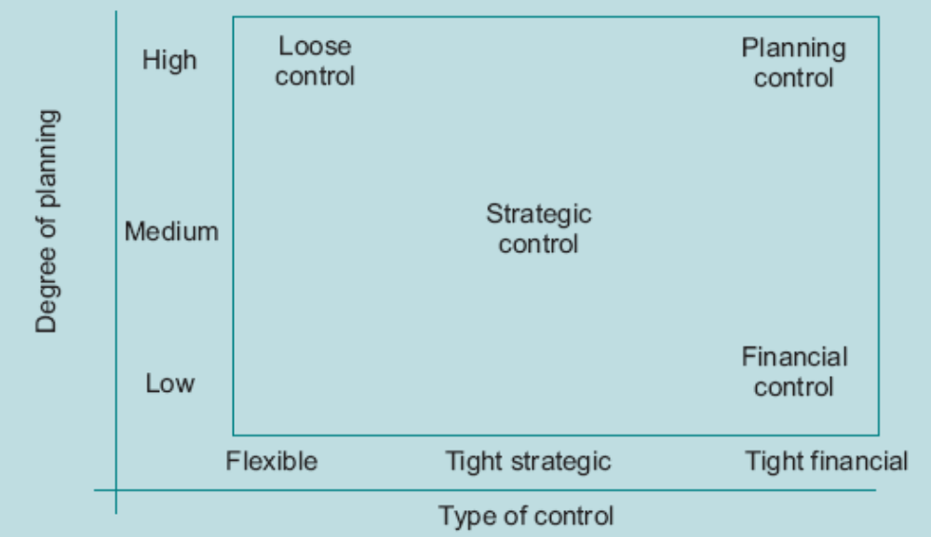
Evaluation and Control
The steps in evaluation and control are:
1 - Decide what is to be measured.
2 - Decide how it is to be measured.
3 - Interpret the outcomes.
4 - Convert into policies.
Some companies rely largely on financial indicators, while others take into account a wider range of measures which reflect competitive positioning – ex balanced score card.
Strategic control:
- Uses combination of measurable
and subjective criteria that enable judgements to be exercised in the light of changing circumstances.
-Uses a variety of control methods and gives a balanced weighting to planning and control influences.
EBS MBA / AUC

Slide 19
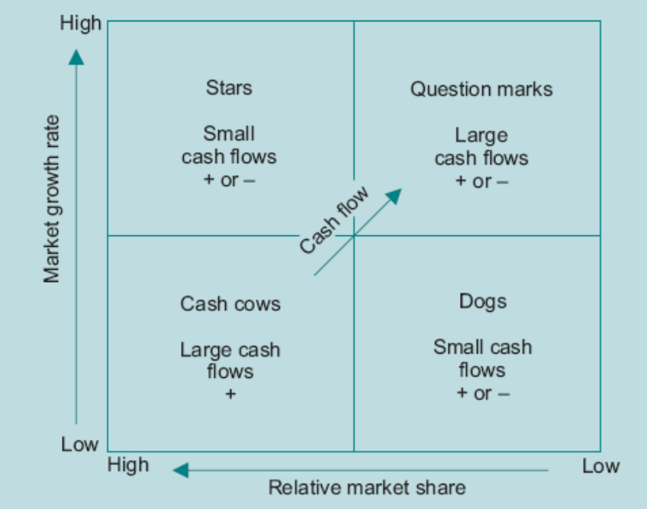
Evaluation and Control
1. Monitoring Market Share
2. Monitoring Profitability
many ways of measuring the
profitability of a company,
and different answers can be .
obtained depending on which
approach
  Profit
  Net Contribution:
  indicator of how effectively
  inputs are being converted into outputs.
  Cash Flow
Net income = Total market × Market share
× (Price − Unit cost)
− Marketing expenditure
Figure 8.2 BCG and cash flow
EBS MBA / AUC

Slide 20
Contents
Implementing Plans 8/2
Organizational Structure 8/3
Resource Allocation 8/6
  Management of Change 8/6
  Critical Success Factors 8/7
  Management Style 8/7
  Budgets 8/8
  Incentives and Alignment 8/9
  Setting Sales Targets 8/10
  Resource Planning 8/11
Evaluation and Control 8/12
  Monitoring Market Share 8/14
  Monitoring Profitability 8/15
Feedback 8/18
The Augmented Process Model 8/19
Postscript: Strategic Planning Works 8/23
EBS MBA / AUC

Slide 21
Feedback
Therefore it is not sufficient to scan the environment and monitor company performance; it is necessary to be able to act on information and changes as they occur.
There are at least three dimensions to effective feedback.
Company Adaptability
  attitude to change.
  willingness of individuals to listen to information which may often not be to their liking,
  Be prepared to admit mistakes, and be proactive.
Company Communications
  How is information disseminated both upwards and downwards
  Company structure is key in this
Company Learning
  Ability of organisation to learn from and build on past experience
  Reinvent the wheel each time!
  organisation as a whole capitalises on the learning of the individualsm is key.
EBS MBA / AUC

Slide 22
Contents
Implementing Plans 8/2
Organizational Structure 8/3
Resource Allocation 8/6
  Management of Change 8/6
  Critical Success Factors 8/7
  Management Style 8/7
  Budgets 8/8
  Incentives and Alignment 8/9
  Setting Sales Targets 8/10
  Resource Planning 8/11
Evaluation and Control 8/12
  Monitoring Market Share 8/14
  Monitoring Profitability 8/15
Feedback 8/18
The Augmented Process Model 8/19
Postscript: Strategic Planning Works 8/23
EBS MBA / AUC

Slide 23
The Augmented Process Model
It is only by the consistent application of a wide range of tools that a company’s competitiveness can be properly assessed.
The STRUCTURED approach coupled with the identification of relevant models is the key to build the strategic insight.
EBS MBA / AUC

Slide 24
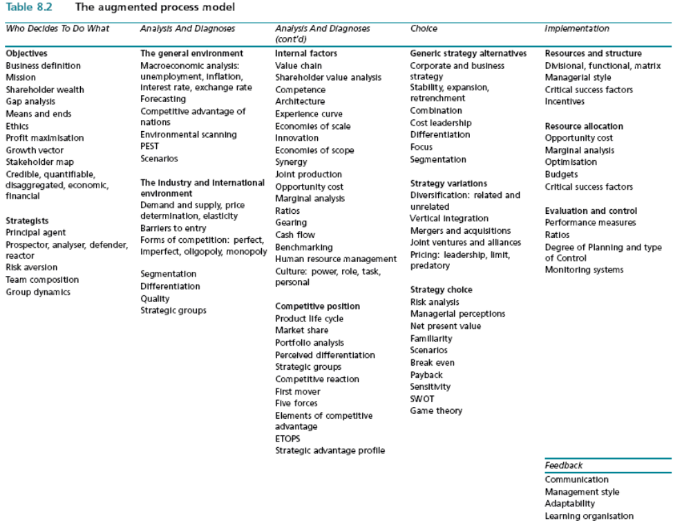
The Augmented Process Model
EBS MBA / AUC

